Slide 1
Mathematical Modeling
Will
Machine Learning
?
Replace
What will happen in a civilized society with backward calculus but deep learning?

Slide 2
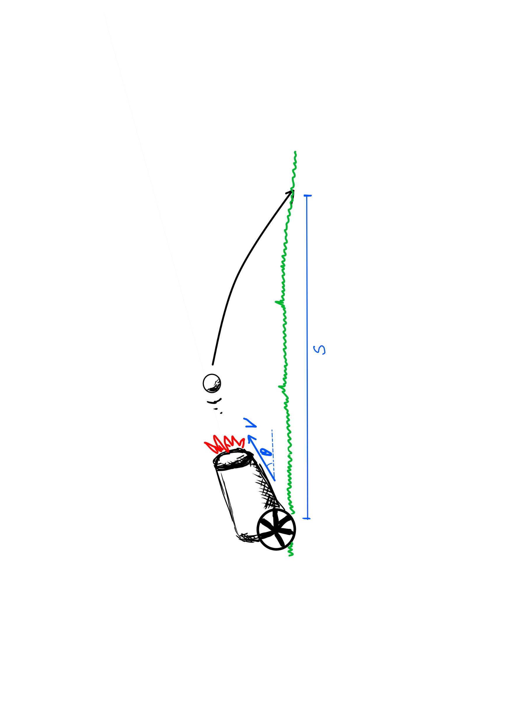
A Fictional Civilization
s = F ( v , θ )
without any relavant knowledge reserve
for the movement of shells in the air
they can get:
1、the primary speed of the shell v
2、the primary angle of the shell θ
3、the final straight range s
they are committed to
using Artillery
to attack opponents
they adopt a data-driven approach
Scientists try to model
the attackable range
of the artillery
Calculus is backward but
Deep Learning is developed
we are in such a
Civilized Society

Slide 3
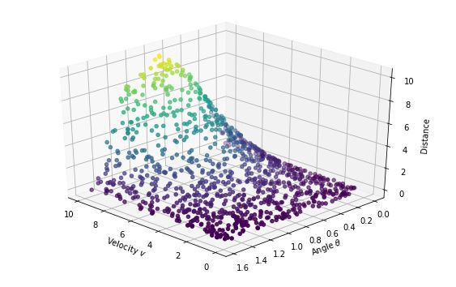
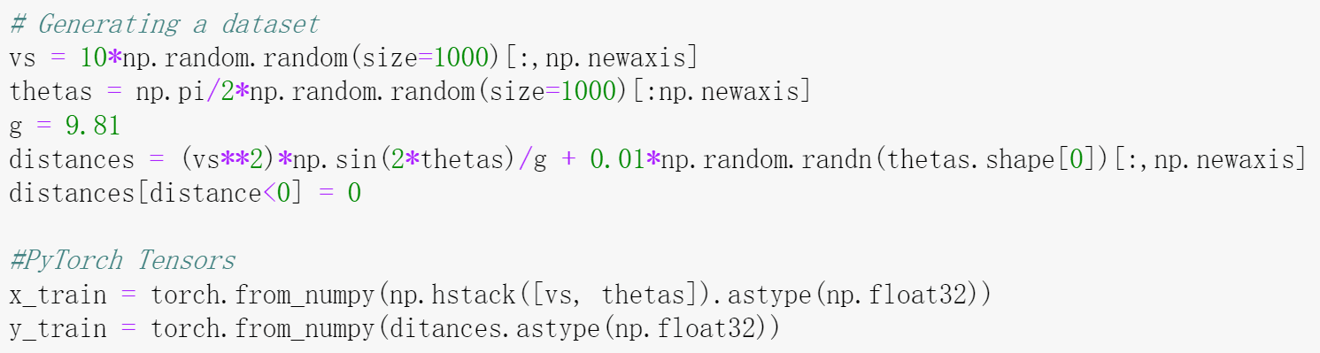
Data Collection
they fired a thousand shells,
producing a thousand ternary arrays
( vi , θi , si )
they spend a day in a variety of
firepower and direction
for cannon shooting
they fired a thousand shells,
producing a thousand ternary arrays
( vi , θi , si )

Slide 4
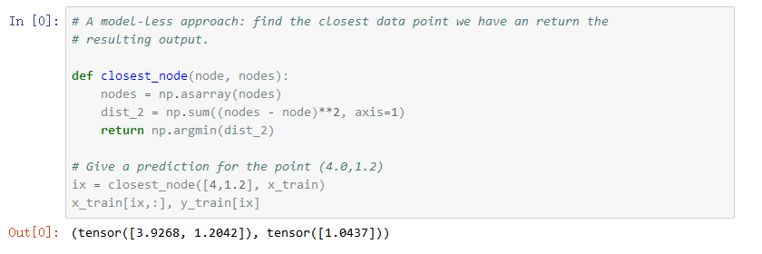
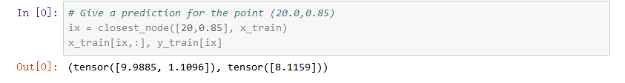
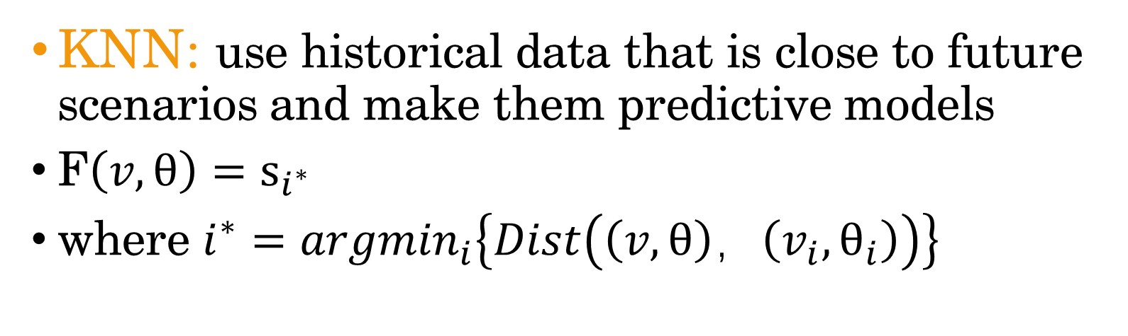
Method Without Model: KNN
KNN: use historical data that is close to future scenarios and make them predictive models
KNN: use historical data that is close to future scenarios and make them predictive models
F$\left(v,θ\right)=s_{i^{∗}}$
where $i^{∗}={argmin}_{i}\left\{Dist\left(\left(v,θ\right)，\left(v_{i},θ_{i}\right)\right)\right\}$
The easiest way to solve it is to
make the data into a model
if the data they get cannot cover all the input possibilities, or the data is too spare, what will happen?

Slide 5
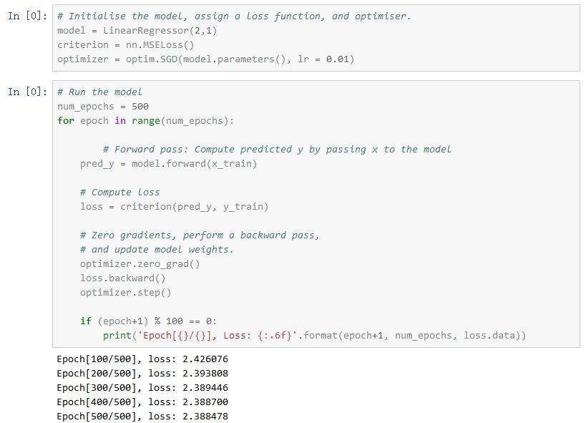
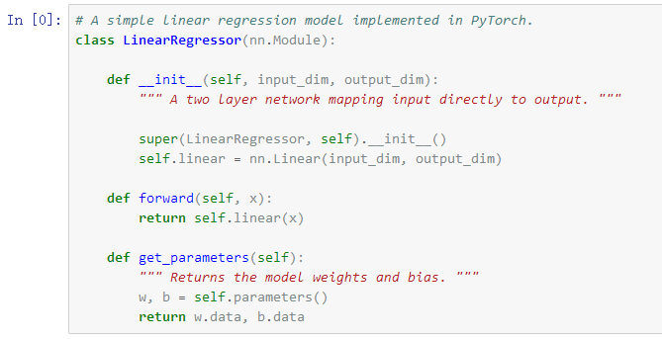
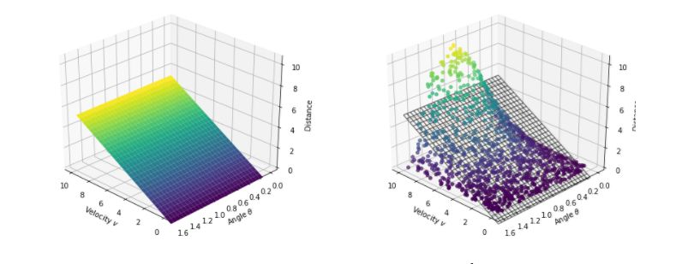
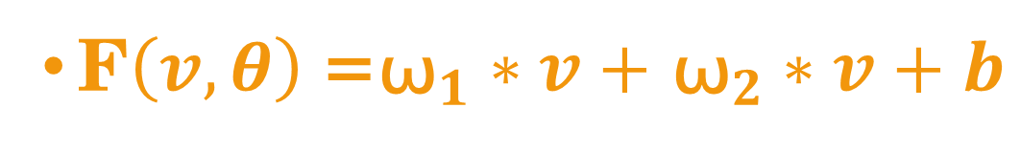
By Linear Model
the modeling results are very bad
Obviously, the function they expect is nonlinear,
and the linear model is unlikely,
but it is the basic model in many application scenarios
F$\left(v,θ\right)$=${\text{ω}}_{1}∗v+$ ${\text{ω}}_{2}∗v+b$

Slide 6
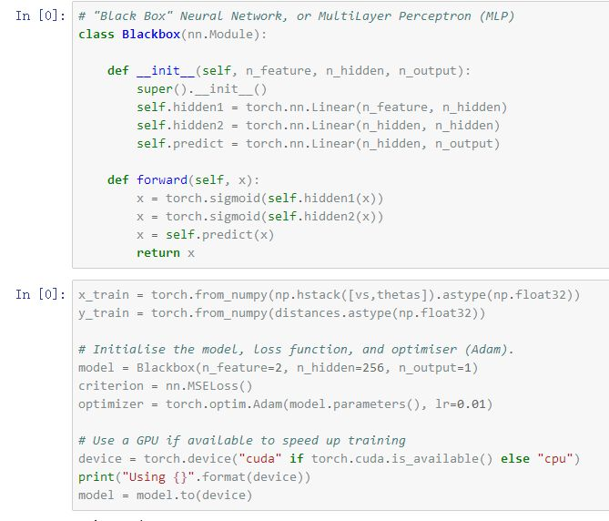
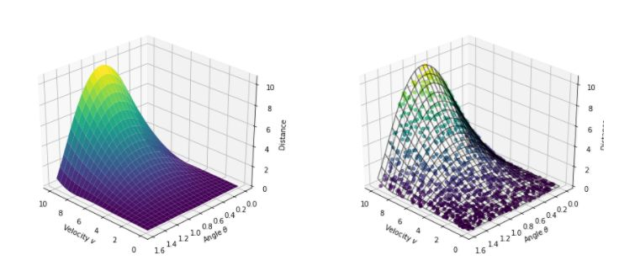
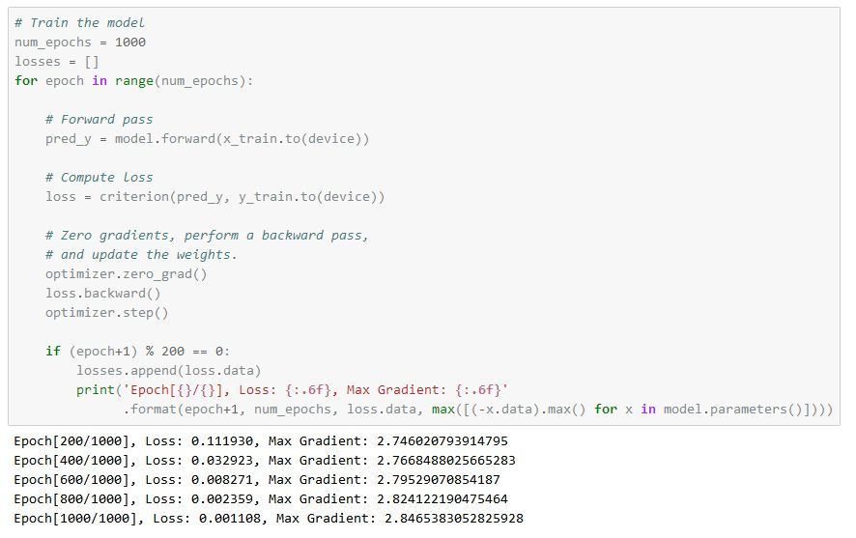
Deep Neural Network
Linear（2,256）->Sigmoid
Sigmoid->Linear（256,256）
Linear（256,256）->Sigmoid
Sigmoid->Linear（256,1）
They like to envision solutions in a deep neural network when faced with problems.

Slide 7
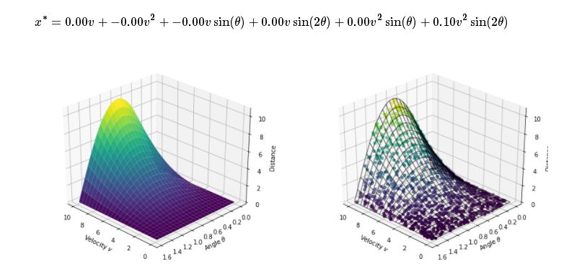
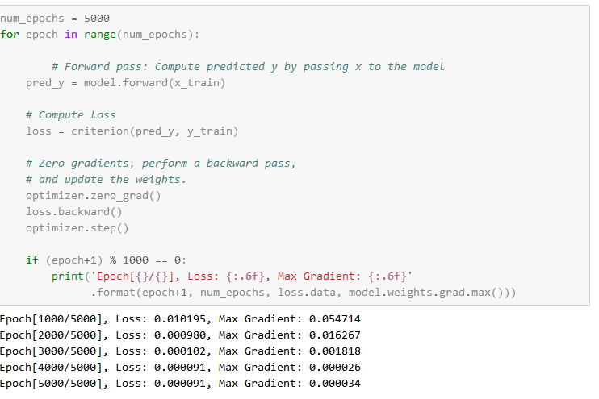
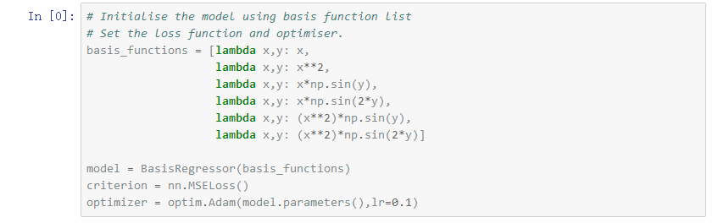
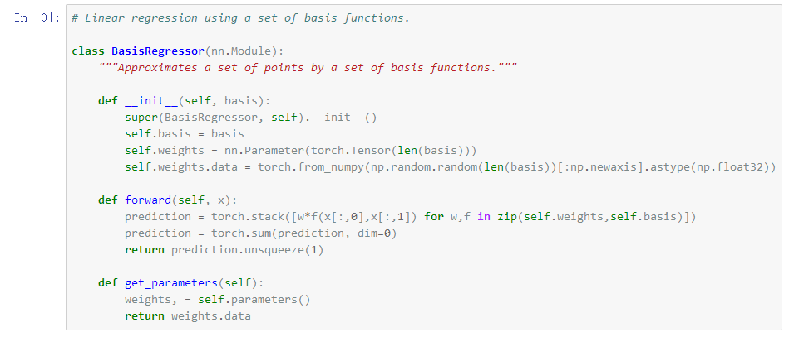
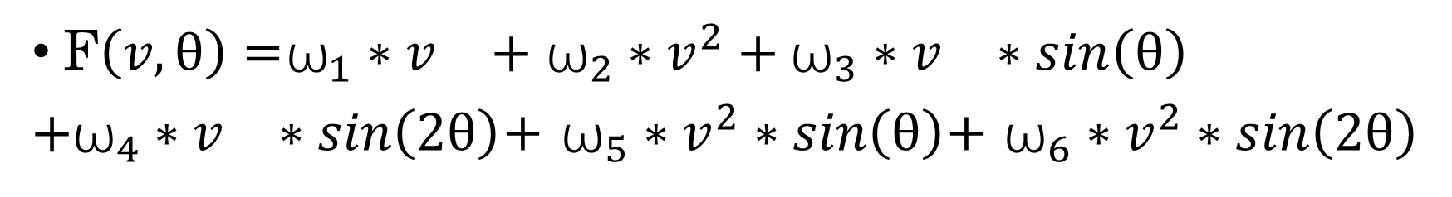
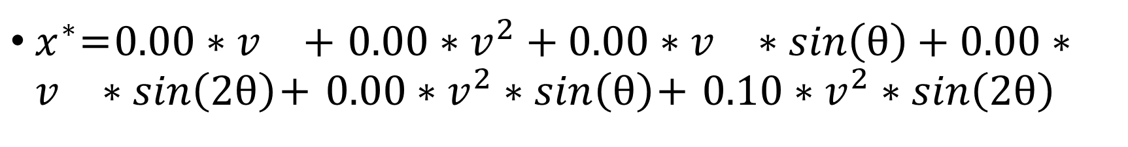
Embedding Nonlinear Models
$x^{∗}$=$0.00∗v^{}+$ $0.00∗v^{2}+0.00∗v^{}∗sin\left(θ\right)+0.00∗v^{}∗sin\left(2θ\right)$+ $0.00∗v^{2}∗sin\left(θ\right)$+ $0.10∗v^{2}∗sin\left(2θ\right)$
Scientists believe that this problem may involve the product of trigonometric functions and velocity.
So they wrote the model as a linear combination of nonlinear basis functions.
F$\left(v,θ\right)$=${\text{ω}}_{1}∗v^{}+$ ${\text{ω}}_{2}∗v^{2}+{\text{ω}}_{3}∗v^{}∗sin\left(θ\right)$
$+{\text{ω}}_{4}∗v^{}∗sin\left(2θ\right)$+ ${\text{ω}}_{5}∗v^{2}∗sin\left(θ\right)$+ ${\text{ω}}_{6}∗v^{2}∗sin\left(2θ\right)$

Slide 8
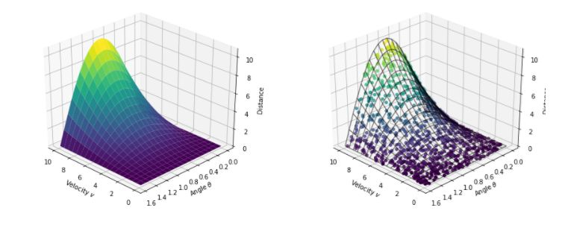
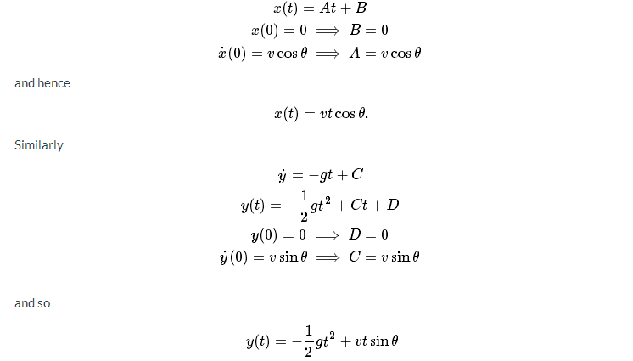
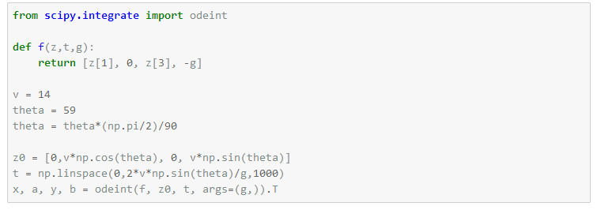
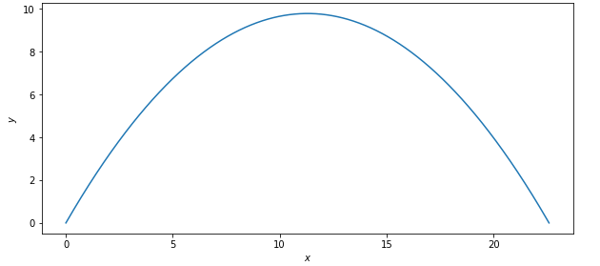
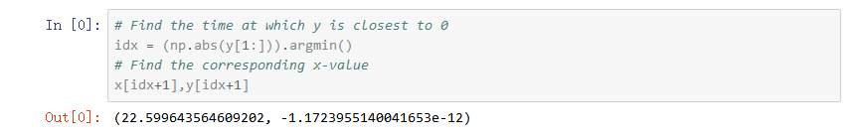
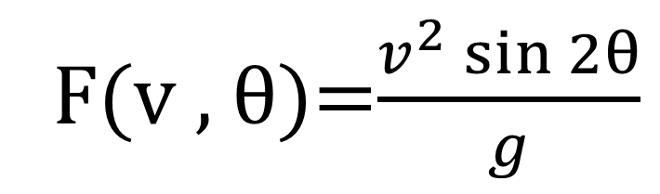
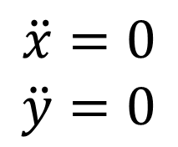
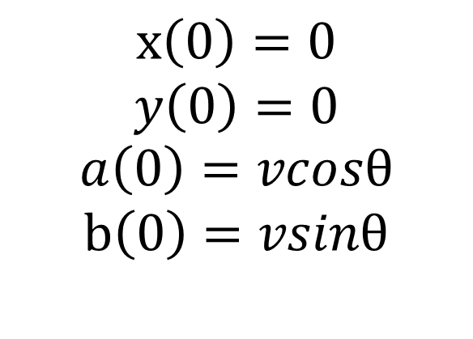
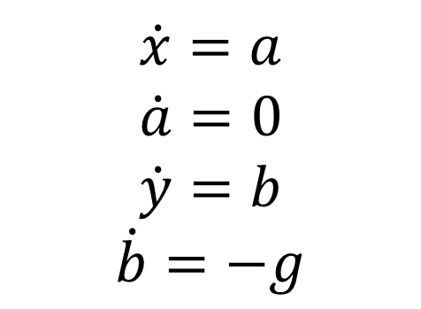
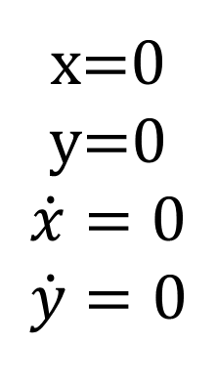
Mathematical Method
step3 Direct solution
step1 assumption equation
step2 numerical integration
x=0
y=0
$$\dot{x}=0$$
$$\dot{y}=0$$
$$\dot{x}=a$$
$$\dot{a}=0$$
$$\dot{y}=b$$
$$\dot{b}=−g$$
$$\ddot{x}=0$$
$$\ddot{y}=0$$
after many years
calculus was finally discovered
$$x\left(0\right)=0$$
$$y\left(0\right)=0$$
$$a\left(0\right)=vcosθ$$
$$b\left(0\right)=vsinθ$$
F(v , θ)=$\frac{v^{2}\sin{2θ}}{g}$
Euler equation

Slide 9
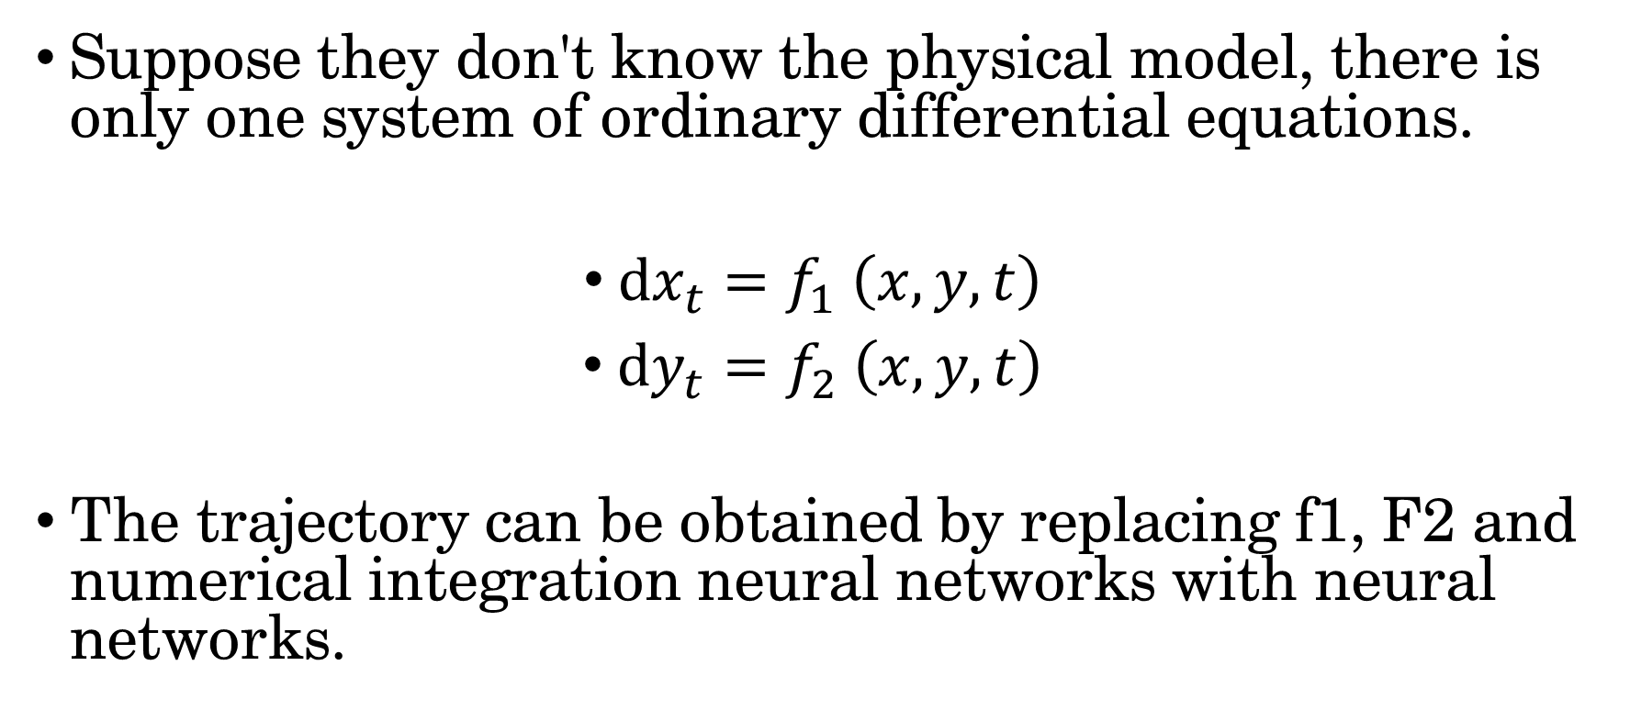
Neural Ordinary Differential Equation Method—Learning Power System
Suppose they don't know the physical model, there is only one system of ordinary differential equations.
$dx_{t}=f_{1} \left(x,y,t\right)$
$dy_{t}=f_{2} \left(x,y,t\right)$
The trajectory can be obtained by replacing f1, F2 and numerical integration neural networks with neural networks.

Slide 10
Mathematical modeling
and
machine learning modeling
should also be
"cooperative relationship“
rather than
"competitive relationship"
Thank you

